Slide 1
MY JOURNAL TO PYTHON
NAME: JAMES RYAN PREGON
TEACHER: MY DEAR GREAT TEACHER

Slide 2
AGENDA
Python
Input and output: input() and print()
Data types:
Operators ON data type:
CONTROLS : IF- | IF –ELSIF |-F-ELSE
LOOP: FOR |WHILE | RANGE() | BREAK | CONTINUE
FUNCTION:
PARAMETERS(ARGUMETNS)
RECURSIVE FUNCTION
LAMBDA FUNCTION

Slide 3
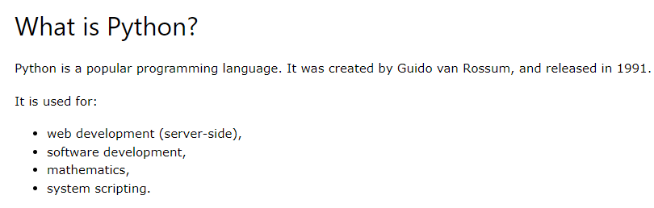
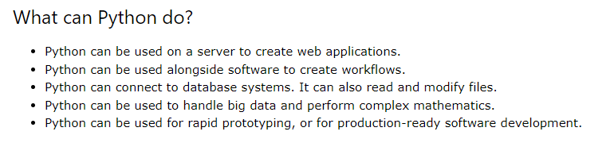
PYTHON

Slide 4
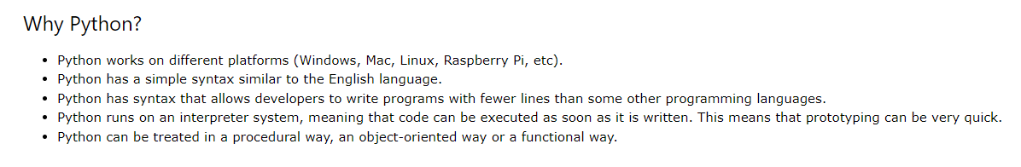
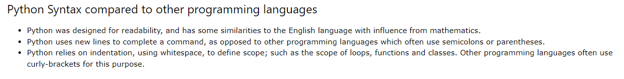
PYTHON

Slide 5


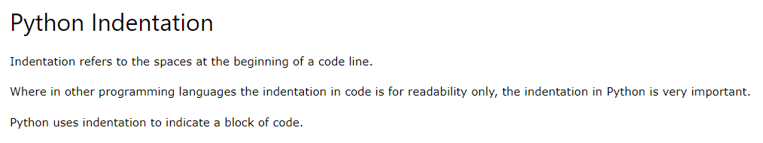


My First Program
Code and output

Slide 6
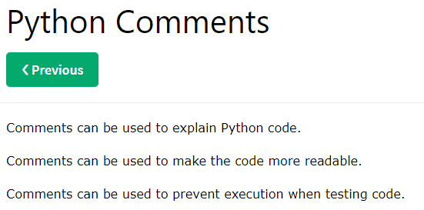
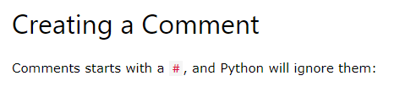


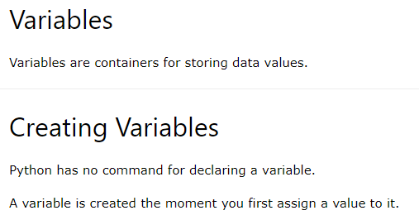
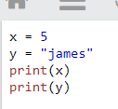

Code and output
Python Variables
Code and output

Slide 7
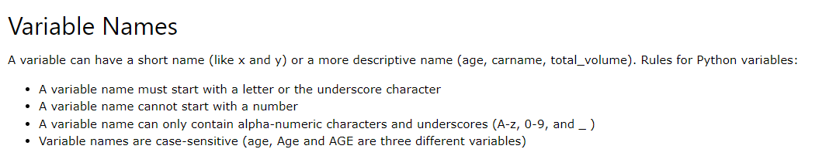
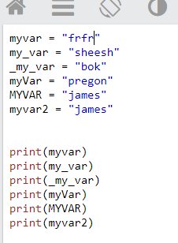
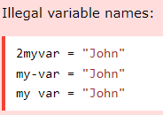
Python - Variable Names
Legal variable name

